Slide 1
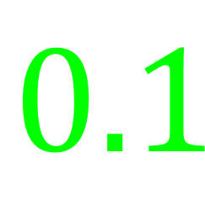
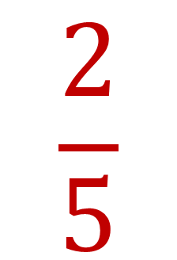


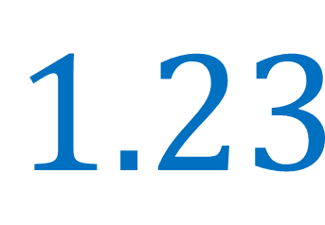
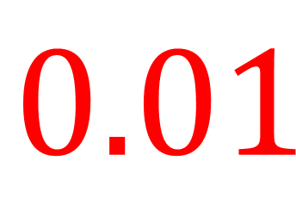
My Fractions and Decimals
Interactive Notebook
$$\frac{1}{2}$$
$$\frac{9}{8}$$
$$0.1$$
$$1.23$$
Name
Class
Teacher
Term 2 Semester 1
$$\frac{2}{5}$$
$$0.01$$
1

Slide 2
Create your own front page
It needs to contain the following –
My number interactive notebook
Name
Class
Teachers Name
Semester 1 Term 1
Page number 1

Slide 3
Contents
Glossary or Formula Page
Page
Date
Description
2
3

Slide 4
Tasks
24
7
30
Essential Question
Questions
Notes
Summary
4
5

Slide 5
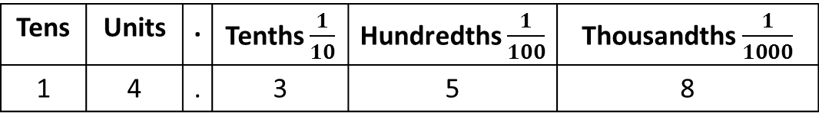
24
7
30
Date
Ordering decimals
EQ – How do I use place value to order decimals?
What is the place value of the digits in a number with decimals?
Tens | Units | . | Tenths $\frac{1}{10}$ | Hundredths $\frac{1}{100}$ | Thousandths $\frac{1}{1000}$
1 | 4 | . | 3 | 5 | 8
Gives the decimal 14.358
5

Slide 6
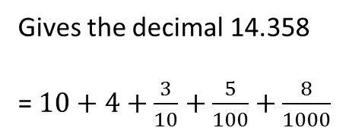
24
7
30
Date
Ordering decimals
EQ – How do I use place value to order decimals?
What is the place value of the digits in a number with decimals?
Tens | Units | . | Tenths $\frac{1}{10}$ | Hundredths $\frac{1}{100}$ | Thousandths $\frac{1}{1000}$
1 | 4 | . | 3 | 5 | 8
Gives the decimal 14.358
= $10+4+\frac{3}{10}+\frac{5}{100}+\frac{8}{1000}$
5

Slide 7
24
7
30
Date
Ordering decimals
EQ – How do I use place value to order decimals?
What is the place value of the digits in a number with decimals?
Tens | Units | . | Tenths $\frac{1}{10}$ | Hundredths $\frac{1}{100}$ | Thousandths $\frac{1}{1000}$
1 | 4 | . | 3 | 5 | 8
Gives the decimal 14.358
= $10+4+\frac{3}{10}+\frac{5}{100}+\frac{8}{1000}$
To order decimals –
Write in a column with the decimals points lined up
Example – Write the following in ascending order.
0 . 512
0 . 51
0 . 5
0 . 056
5

Slide 8
24
7
30
Date
Ordering decimals
EQ – How do I use place value to order decimals?
What is the place value of the digits in a number with decimals?
Tens | Units | . | Tenths $\frac{1}{10}$ | Hundredths $\frac{1}{100}$ | Thousandths $\frac{1}{1000}$
1 | 4 | . | 3 | 5 | 8
Gives the decimal 14.358
= $10+4+\frac{3}{10}+\frac{5}{100}+\frac{8}{1000}$
To order decimals –
Write in a column with the decimals points lined up.
Add any zeros so the numbers have the same number of decimal places.
Example – Write the following in ascending order.
0 . 512
0 . 51
0 . 5
0 . 056
5

Slide 9
24
7
30
Date
Ordering decimals
EQ – How do I use place value to order decimals?
What is the place value of the digits in a number with decimals?
Tens | Units | . | Tenths $\frac{1}{10}$ | Hundredths $\frac{1}{100}$ | Thousandths $\frac{1}{1000}$
1 | 4 | . | 3 | 5 | 8
Gives the decimal 14.358
= $10+4+\frac{3}{10}+\frac{5}{100}+\frac{8}{1000}$
To order decimals –
Write in a column with the decimals points lined up.
Add any zeros so the numbers have the same number of decimal places.
Write in order
Example – Write the following in ascending order.
0 . 512
0 . 510
0 . 500
0 . 056
5

Slide 10
24
7
30
Date
Ordering decimals
EQ – How do I use place value to order decimals?
What is the place value of the digits in a number with decimals?
Tens | Units | . | Tenths $\frac{1}{10}$ | Hundredths $\frac{1}{100}$ | Thousandths $\frac{1}{1000}$
1 | 4 | . | 3 | 5 | 8
Gives the decimal 14.358
= $10+4+\frac{3}{10}+\frac{5}{100}+\frac{8}{1000}$
To order decimals –
Write in a column with the decimals points lined up.
Add any zeros so the numbers have the same number of decimal places.
Write in order
Example – Write the following in ascending order.
0 . 512 0.056
0 . 510
0 . 500
0 . 056
5

Slide 11
24
7
30
Date
Ordering decimals
EQ – How do I use place value to order decimals?
What is the place value of the digits in a number with decimals?
Tens | Units | . | Tenths $\frac{1}{10}$ | Hundredths $\frac{1}{100}$ | Thousandths $\frac{1}{1000}$
1 | 4 | . | 3 | 5 | 8
Gives the decimal 14.358
= $10+4+\frac{3}{10}+\frac{5}{100}+\frac{8}{1000}$
To order decimals –
Write in a column with the decimals points lined up.
Add any zeros so the numbers have the same number of decimal places.
Write in order
Example – Write the following in ascending order.
0 . 512 0.056
0 . 510 0.5
0 . 500
0 . 056
5

Slide 12
24
7
30
Date
Ordering decimals
EQ – How do I use place value to order decimals?
What is the place value of the digits in a number with decimals?
Tens | Units | . | Tenths $\frac{1}{10}$ | Hundredths $\frac{1}{100}$ | Thousandths $\frac{1}{1000}$
1 | 4 | . | 3 | 5 | 8
Gives the decimal 14.358
= $10+4+\frac{3}{10}+\frac{5}{100}+\frac{8}{1000}$
To order decimals –
Write in a column with the decimals points lined up.
Add any zeros so the numbers have the same number of decimal places.
Write in order
Example – Write the following in ascending order.
0 . 512 0.056
0 . 510 0.5
0 . 500 0.51
0 . 056
5

Slide 13
24
7
30
Date
Ordering decimals
EQ – How do I use place value to order decimals?
What is the place value of the digits in a number with decimals?
Tens | Units | . | Tenths $\frac{1}{10}$ | Hundredths $\frac{1}{100}$ | Thousandths $\frac{1}{1000}$
1 | 4 | . | 3 | 5 | 8
Gives the decimal 14.358
= $10+4+\frac{3}{10}+\frac{5}{100}+\frac{8}{1000}$
How do I write in order?
To order decimals –
Write in a column with the decimals points lined up.
Add any zeros so the numbers have the same number of decimal places.
Write in order
Example – Write the following in ascending order.
0 . 512 0.056
0 . 510 0.5
0 . 500 0.51
0 . 056 0.512
5

Slide 14
Notes Review
24, 7 ,30
Date
Title
Essential question
Notes complete
Notes complete with colour and diagrams
Questions completed
Contents page filed in
Formula page filled in

Slide 15
Homework
Review your notes and write a summary answering the essential question.

